Slide 1
Ch09 Graph plotting and data visualization
Highlights of the chapter:
13.1 Overview of the Python drawing module
13.2 Matplotlib Module
13.3 Matplotlib Basic Plotting
13.4 Plotting Common Chart Types
13.5 Object-Oriented Matplotlib Plotting

Slide 2
Overview of the Python Drawing Module
The Python standard library includes
tkinter (canvas drawing)
Turtle
Python provides a large number of high-quality third-party drawing libraries, commonly used open-source drawing module libraries are as follows
(1) Matplotlib: Matplotlib can draw a variety of forms of graphs, including ordinary line graphs, histograms, pie charts, scatter plots, and error line graphs, etc.; you can also customize the various attributes of the graphs, such as the type of graphs, color, thickness, font size, etc. More than that, you can also customize the graphs.
(2) Seaborn: Seaborn is a third-party library based on Matplotlib, and supports NumPy and Pandas. Seaborn can effectively visualize statistical data, and provides a number of high-level statistical data visualization effects. the official website of Seaborn is located at "https://seaborn.pydata.org/"
(3) Python Google Chart. Python Google Chart is a complete package of Google Chart API, its official website address "http://pygooglechart.slowchop.com/".
(4) Pychart. Pychart is a Python library for creating high-quality encapsulated PostScript, PDF, PNG, or SVG charts and graphs, and its official website address is "http://home.gna.org/pychart/".
(5) PLPlot. PLPlot is a cross-platform software package for creating scientific diagrams, centered on C libraries and supporting a variety of languages (C, C++, Fortran, Java, Python, etc.), whose official website is "http://plplot.sourceforge.net/ "

Slide 3
Plotting based on Matplotlib module
Matplotlib is one of Python's best-known plotting libraries, providing a set of command APIs similar to those of MATLAB, which are suitable for interactive plotting and can be easily embedded as a plotting control in GUI applications.
Matplotlib's pyplot sub-library provides a plotting API similar to that of MATLAB, allowing users to quickly draw 2D charts, including histograms, pie charts, scatter plots, etc.
Matplotlib with the NumPy module to visualize the results of scientific calculations.

Slide 4
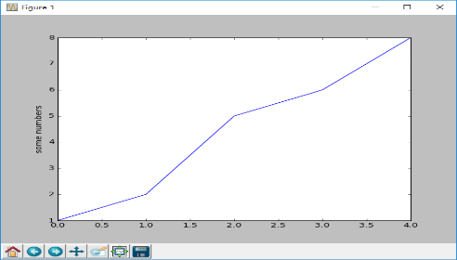
Overview of Plotting with the Matplotlib Module
Installing the Matplotlib module
The official website for Matplotlib is http://matplotlib.org/. You can download and install the Matplotlib module directly from the official website
Plotting with the Matplotlib module, mainly using the Matplotlib.pyplot toolkit
Matplotlib is a suite of object-oriented plotting libraries, where each plotting element (e.g., lines, text, scales, etc.) in the diagrams it draws is an object
[Example 13.1] Use the plot() function to draw a graph (linecurve.py): draw the list [1, 2, 5, 6, 8], i.e., a line plot with x-axis coordinates of 0, 1, 2, 3, 4, and corresponding y-axis coordinates of 1, 2, 5, 6, and 8
import matplotlib.pyplot as plt #Import the submodule pyplot from the matplotlib module
plt.plot([1, 2, 5, 6, 8]) #plot list
plt.ylabel('some numbers') #set y-axis coordinates title
plt.show() # display the graph

Slide 5
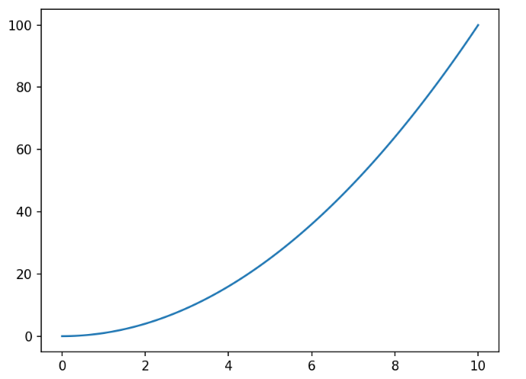
Plotting line graphs: using two lists of data
[Example 13.2] Plot a line graph of y = x2 (squarex.py). Use numpy's linspace() function to generate a list of coordinate points on the x-axis that takes values in the range of 100 points in [0,10], then compute y = x*x, and finally plot a line graph
import matplotlib.pyplot as plt #import module
import numpy as np #import module
x = np.linspace(0,10,100) #generate a list of x coordinate points
y = x*x #Generate a list of x-coordinate points (y = x*x)
plt.plot(x, y) #plot the figure
plt.show() # display the graph

Slide 6
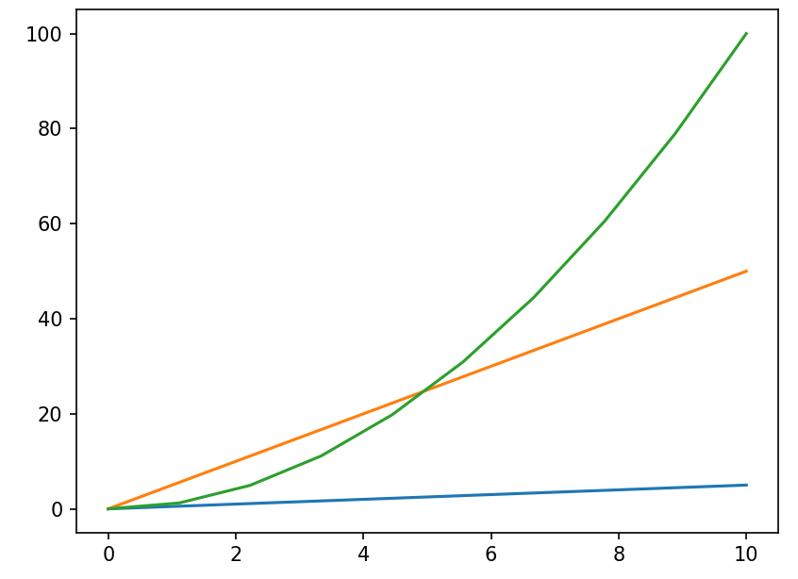
Drawing multiple shapes
[Example 13.3] Write a program (line3.py) to plot multiple function curves y = 0.5x, y = 5x, and y = x2 in the same graph
import matplotlib.pyplot as plt #import module
import numpy as np #import module
x = np.linspace(0,10,10) #generate a list of x coordinate points
plt.plot(x, x * 0.5) #plot the graph y = 0.5x
plt.plot(x, x * 5) #plot the graph y = 5x
plt.plot(x, x * x) #plot the graph y = x*x
#plt.plot(x, x*0.5, x, x*5, x, x*x) #Or you can use one statement to plot multiple graphs at the same time
plt.show() # display the graph

Slide 7
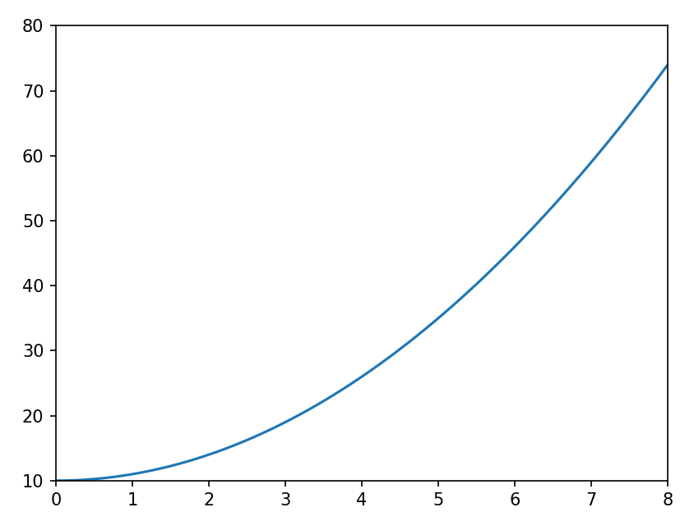
Setting the Axis Range
[Example 13.4] Write a program (axisScope.py) that plots the graph y = 10 + x2 and sets the range of the x-axis to [0, 8] and the range of the y-axis to [10, 80].
import matplotlib.pyplot as plt #import module
import numpy as np #import module
x = np.linspace(0,8,100) #generate a list of x coordinate points
plt.axis([0,8,10,80]) #Set the range of the two axes
plt.plot(x, 10 + x*x) #plot graphs
plt.show() # display the graph

Slide 8
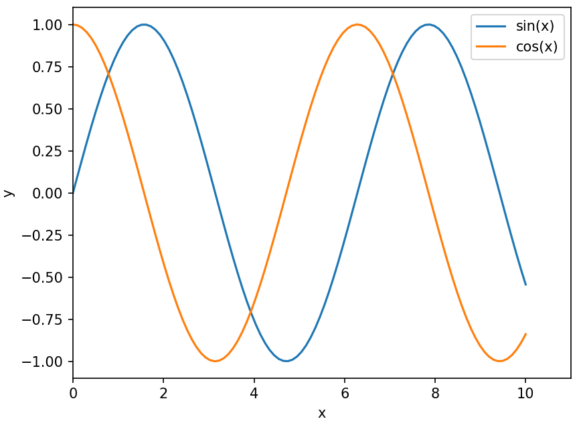
Plotting both sine and cosine curves in a single graph
[Example 13.5] Write a program (sincos.py) that plots both sine and cosine curves in a graph, setting the range of the x-axis to [0, 11] and the range of the y-axis to [-1.1, 1.1].
import matplotlib.pyplot as plt #import module
import numpy as np #import module
x = np.linspace(0,10,100) #generate a list of x coordinate points
plt.plot(x, np.sin(x), x, np.cos(x)) #plot sine and cosine curves
plt.axis(xmin=0, xmax=11, ymin=-1.1, ymax=1.1) #Set the range of the two axes
plt.xlabel('x') #set x-axis axis title
plt.ylabel('y') #Set the y-axis axis title
plt.legend(['sin(x)','cos(x)'],loc='upper right') #set the legend
plt.savefig('plot1.png') #save the graph to a file
plt.show() # display the graph

Slide 9
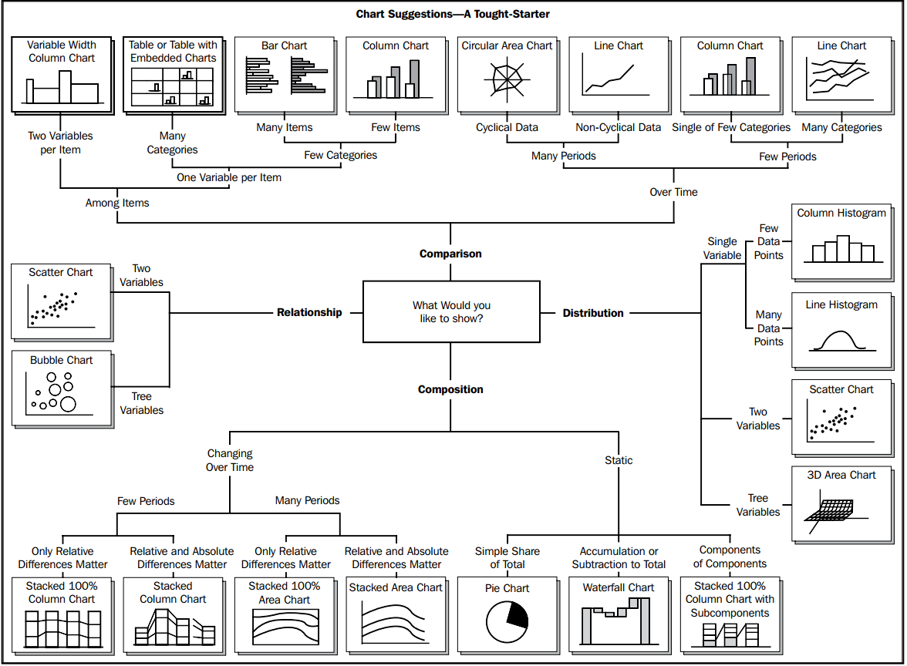
Select chart type

Slide 10
Bar chart (1)
[Example 13.6] Use the Matplotlib module to draw a vertical bar chart (bar1.py) of the annual sales of products in each region, with the chart title "Annual sales of products in each region", the x-axis title "Region", the x-axis scale labeled "Central China, South China, East China, North China, West China", the y-axis title is "sales", each region's sales information using different color representation
import matplotlib.pyplot as plt #import module
plt.rcParams['font.sans-serif']=['SimHei'] #Used to display Chinese labels normally
# of bars identified, which can be thought of as x-axis scales (regions: Central, South, East, North, West China)
x=[1,2,3,4,5] #x-axis scale
y=[5,7,4,3,1] #y-axis scale (sales in millions)
color=['red','black','green','orchid','blue'] #List of colors (red, black, green, lavender, blue)
x_label=['Central China','South China','East China','North China','West China'] #x-axis scale labels
plt.xticks(x, x_label) #plot x-axis tick labels
plt.bar(x, y,color=color) #plot y-axis scale labels
plt.xlabel('region') #plot x-axis coordinates title
plt.ylabel('Sales (in millions)') #plot y-axis coordinates title
plt.title('Annual sales of products by region') #plot chart title
plt.grid(True,linestyle=':',color='r',alpha=0.6) #Set the grid scale
plt.show() #Display vertical bar graphs

Slide 11
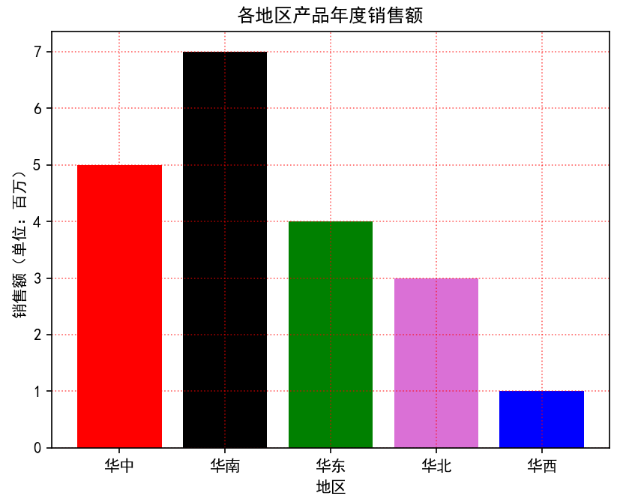
Bar chart (1)
import matplotlib.pyplot as plt #import module
plt.rcParams['font.sans-serif']=['SimHei'] #Used to display Chinese labels normally
# of bars identified, which can be thought of as x-axis scales (regions: Central, South, East, North, West China)
x=[1,2,3,4,5] #x-axis scale
y=[5,7,4,3,1] #y-axis scale (sales in millions)
color=['red','black','green','orchid','blue'] #List of colors (red, black, green, lavender, blue)
x_label=['Central China','South China','East China','North China','West China'] #x-axis scale labels
plt.xticks(x, x_label) #plot x-axis tick labels
plt.bar(x, y,color=color) #plot y-axis scale labels
plt.xlabel('region') #plot x-axis coordinates title
plt.ylabel('Sales (in millions)') #plot y-axis coordinates title
plt.title('Annual sales of products by region') #plot chart title
plt.grid(True,linestyle=':',color='r',alpha=0.6) #Set the grid scale
plt.show() #Display vertical bar graphs

Slide 12
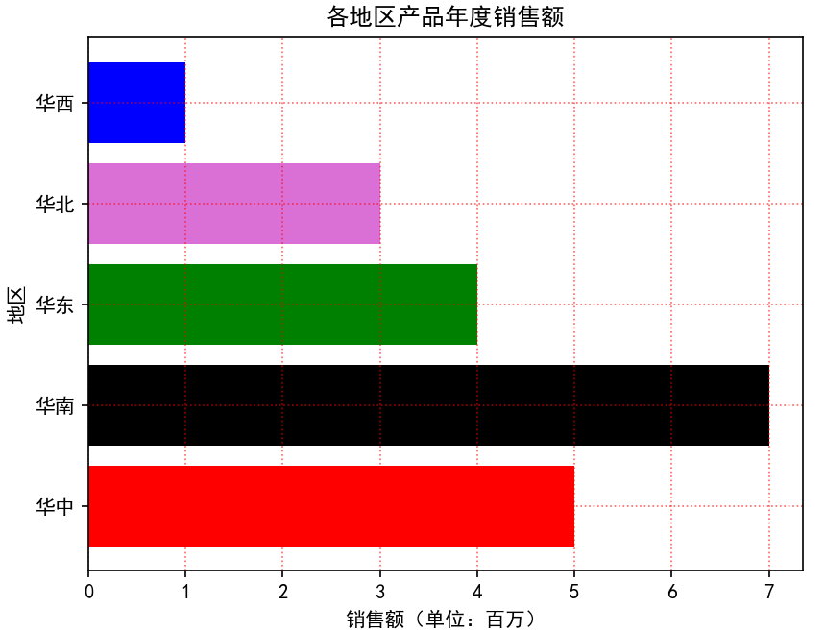
Bar charts (2)
[Example 13.7] Using the Matplotlib module to plot a histogram of annual product sales levels by region (bar2.py)
import matplotlib.pyplot as plt #import module
plt.rcParams['font.sans-serif']=['SimHei'] #Used to display Chinese labels normally
x=[5,7,4,3,1] #x-axis scale (sales in millions)
# of bars identified, which can be thought of as a y-axis scale (regions: Central, South, East, North, West China)
y=[1,2,3,4,5]
color=['red','black','green','orchid','blue'] #List of colors (red, black, green, lavender, blue)
y_label=['Central China','South China','East China','North China','West China']
plt.yticks(y, y_label) #plot y-axis tick labels
plt.barh(y, x, color=color) #plot x-axis scale labels
plt.xlabel('Sales (in millions)') #plot x-axis coordinates title
plt.ylabel('region') #plot y-axis coordinates title
plt.title('Annual sales of products by region') #plot chart title
plt.grid(True,linestyle=':',color='r',alpha=0.6) #Set the grid scale
plt.show() #Display a horizontal bar chart

Slide 13
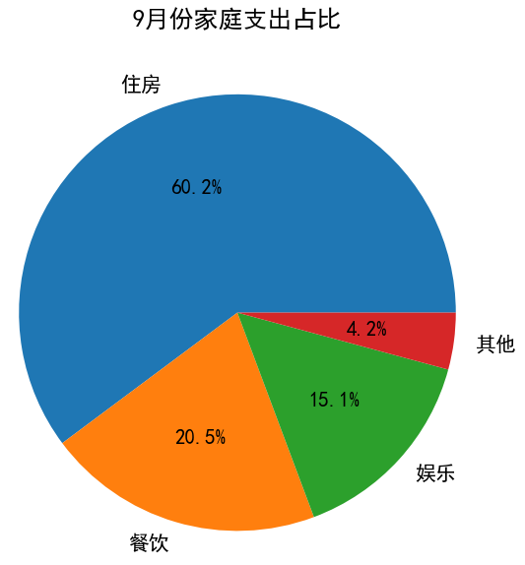
Pie chart (1)
Example 13.8: Use the Matplotlib module to draw a pie chart (pie1.py) of the percentage of a family's expenditures in September, assuming that the expenditures on "housing", "food and drink", "entertainment" and "other" accounted for 60.2%, 20.5%, 15.1% and 4.2% respectively, and the title of the chart is "Percentage of family expenditures in September". "and" other "expenditures accounted for 60.2%, 20.5%, 15.1% and 4.2%, respectively, the title of the chart is "September household expenditure ratio", you need to show the name of the various expenditures and the percentage ( (retain one decimal place)
import matplotlib.pyplot as plt #import module
plt.rcParams['font.sans-serif']=['SimHei'] #Used to display Chinese labels normally
labels = ['Housing','Dining','Entertainment','Other'] #pie chart labels
percentages = [60.2, 20.5, 15.1, 4.2] #Pie chart percentages
plt.pie(percentages,labels=labels,autopct='%1.1f%%') # pie chart parameters
plt.title("Household Expenditures as a Percentage in September") #plot icon title
plt.show() #Display a pie chart

Slide 14
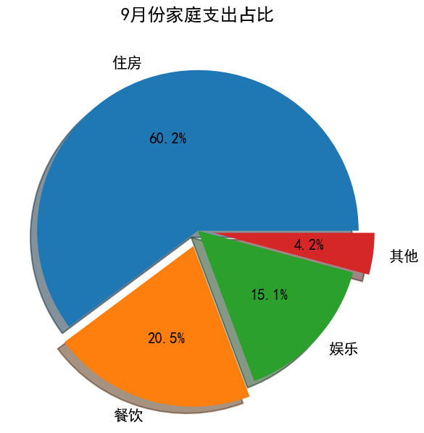
Pie charts (2)
Example 13.9: Use the Matplotlib module to draw a pie chart (pie2.py) of the percentage of each household's expenditure in September, add shading to each pie, and separate out the "Food and Beverage" and "Other" pies.
import matplotlib.pyplot as plt #import module
plt.rcParams['font.sans-serif']=['SimHei'] #Used to display Chinese labels normally
labels = ['Housing', 'Dining', 'Entertainment', 'Other']
explode = (0, 0.1, 0, 0.1) #Separate the 2nd & 4th slices ('restaurant' and 'other')
percentages = [60.2, 20.5, 15.1, 4.2] #Pie chart percentages
plt.pie(percentages,explode=explode,labels=labels,autopct='%1.1f%%', shadow=True)
plt.title("Household Expenditures as a Percentage in September") #Pie Chart Title
plt.show() #Display a pie chart

Slide 15
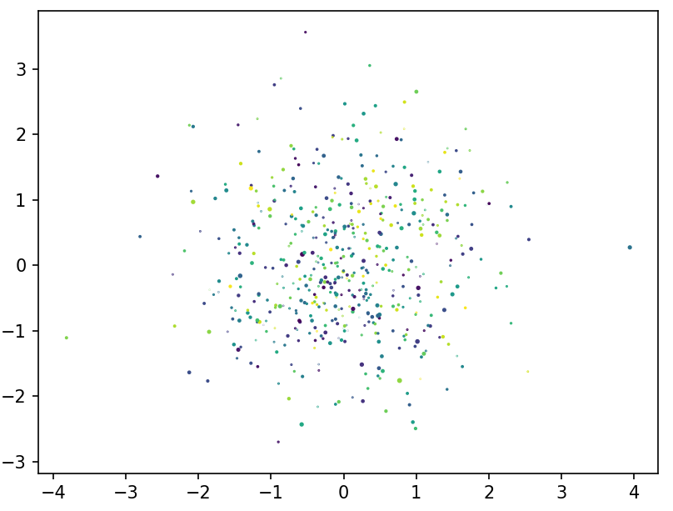
scatterplot
[Example 13.10] Write a program (scatters.py) that generates 1000 random points (x, y) of random size and random color and plots their scatterplots
import matplotlib.pyplot as plt #import module
import numpy as np #import module
x = np.random.randn(1000) #generate x coordinates consisting of 1000 random points
y = np.random.randn(1000) #generate y coordinates consisting of 1000 random points
size = np.random.randn(1000) #generate a size consisting of 1000 random points
colors = np.random.rand(1000) #generate colors consisting of 1000 random dots
plt.scatter(x, y, s=size, c=colors) #plot a scatterplot consisting of 1000 random points
plt.show() # display the graph

Slide 16
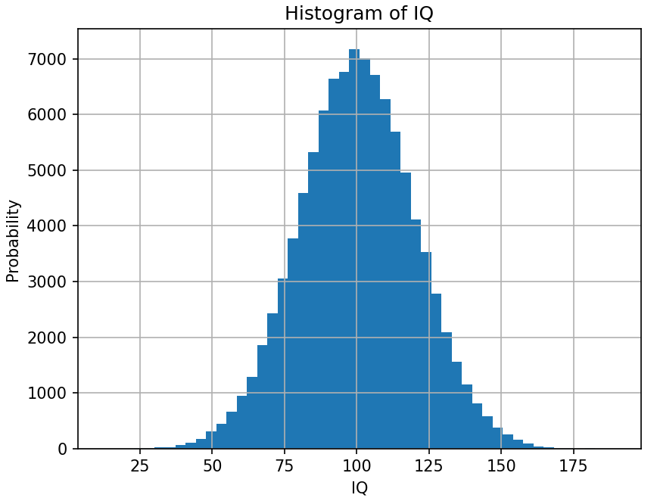
Plotting histograms
[Example 13.11] Example of plotting a histogram using the hist() function of Matplotlib.pyplot (histfig.py): randomly generate 100,000 IQ data that satisfy a normal distribution with a mu of 100 and a sigma of 20, and plot their histograms
import numpy as np #import numpy module
import matplotlib.pyplot as plt #Import the submodule pyplot from the matplotlib module
# Randomly generate 100,000 IQ data satisfying a normal distribution with mu of 100 and sigma of 20
mu, sigma = 100, 20
x = mu + sigma * np.random.randn(100000)
plt.hist(x, bins=50) #plot histograms
plt.xlabel('IQ') #plot x-axis coordinates title
plt.ylabel('Probability') #plot y-axis coordinates title
plt.title('Histogram of IQ') #plot chart title
plt.grid(True) #Display grid
plt.show() #show histograms

Slide 17
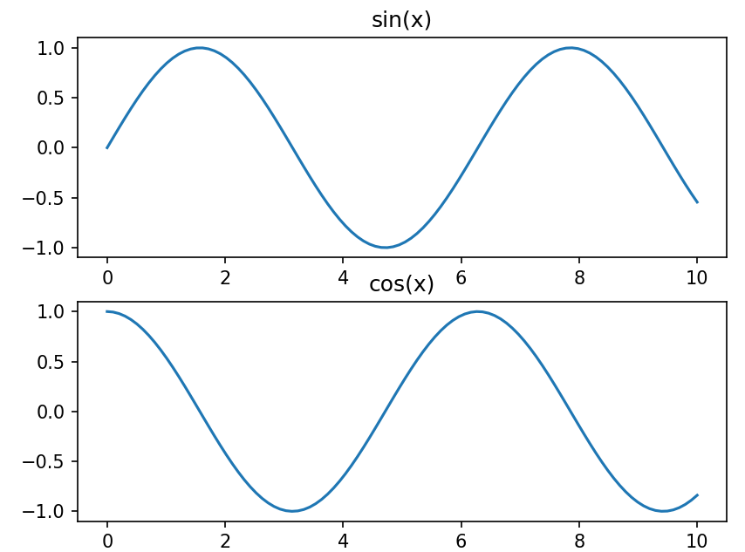
Plotting multiple subgraphs
[Example 13.12] Plotting Multiple Subplots Example (multifigs.py): Plotting y=sin(x) and y=cos(x) using the NumPy module and the Matplotlib.pyplot toolkit.
import matplotlib.pyplot as plt #import module
import numpy as np #import module
x = np.linspace(0, 10, 100) #Generate list data for the x-axis (100 points in the range [0,10])
fig1 = plt.figure() #create a Figure object
ax1 = fig1.add_subplot(2,1,1) #Create a subplot: 1st plot in 2 rows and 1 column
ax1.plot(x, np.sin(x)) #plot y = sin(x)
ax1.set_title('sin(x)') #set chart title
ax2 = fig1.add_subplot(2,1,2) #create a subplot: 2nd plot in 2 rows and 1 column
ax2.plot(x, np.cos(x)) #plot y = cos(x)
ax2.set_title('cos(x)') #set chart title
plt.show() # display the graph

Slide 18
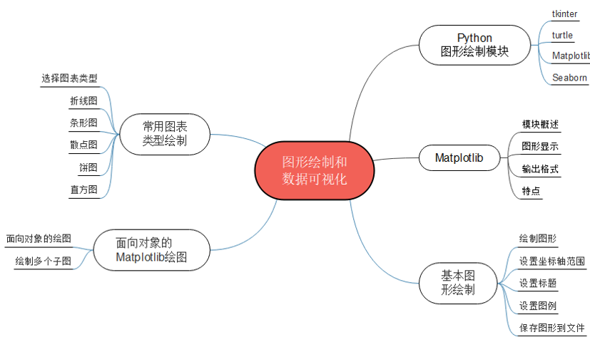
Summary of the chapter

Slide 19
Case Study: Tower of Hanoi Problem Solving Animation
The case study in this chapter is to help the reader gain further insight into recursion and turtle graphs through the design and implementation of a turtle-based animation for solving the Hannauta problem
The rules for solving the Hannauta problem to move the disk are as follows:
(1) Only one disk can be moved at a time
(2) Before taking out a disk, the previous disk must be placed.
(3) A large-diameter disk cannot be placed on top of a small-diameter disk.
Using the transition columns in the middle, it is ultimately possible to move all the disks to the target state
The solution and source code etc. of the case studies are provided in electronic format, please scan the QR code in the tutorial for details

Slide 20
Hannauta problem solving animation design ideas
(1) Design the class Disk that represents a disk. the class Disk is a subclass of the class Turtle, i.e., the Disk object is a Turtle object, and the shape of the Turtle (and thus the representation of different sizes of disks) is set by the parameter n (by the number of the disk) in the constructor.
(2) Design the class Peg that represents the columns.The class Peg is a subclass of Turtle (for visualization) and list (since the columns are containers for the discs). In the constructor, set the shape of the turtle by the parameter n (by the number of the disk) and the position of the turtle by the parameter pos (the position of the column), so that different columns can be represented using turtles of different positions and sizes. Also define the stack method push() for placing the disk to the cylinder, adding the disk object in the cylinder container and setting the proper position of the disk; define the pop() method to remove and return the disk from the cylinder, remove the disk object in the cylinder container and set the position of the disk on top of the cylinder

Slide 21
Hannauta problem solving animation design ideas
(3) Define the move function move_disk(from_peg, to_peg) to move a disk on the cylinder from_peg to the cylinder to_peg.
(4) Define the Hannota recursive solver function hanoi(n, peg1, peg2, peg3) to move n disks from peg1 to peg3 (through the intermediate transition column peg2)
(5) In the main function main(), create three columns that can hold n discs, located at positions -200, 0 and 200 in that order. Then n disc objects are created and placed in peg1 in descending order (call the push() method of peg1). Finally the recursive function hanoi() is called to realize)
(6) Finally, in the test code, call the main function main(5)
[Example CS13.1] Sample program for animating the solution process of the Hannauta problem (hanoi.py)

Slide 22
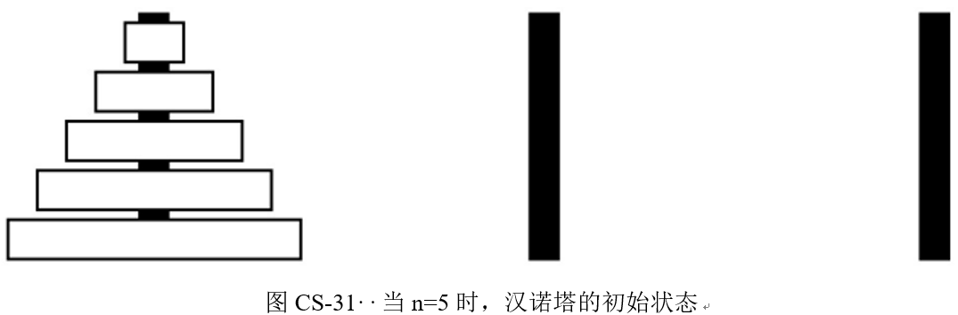
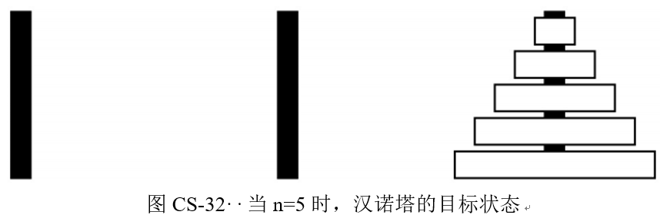
[Example CS13.1] Sample program for animating the solution process of the Hannauta problem (hanoi.py)

Slide 23
Thank!

